Slide 1


F3 – Fun Farewell Friday

Slide 2
Teams
PRIA
BOA
PIM
FIGO

Slide 3

Identify the movie names

Slide 4

Love found jewels and wealth

Slide 5

Aashchray Mahila

Slide 6

Blood filled demand

Slide 7

Andhera Shurveer

Slide 8

Congratulations

Slide 9

Salt Illegal

Slide 10

He who wins is Alexander

Slide 11

One and a half love

Slide 12

Fire Witness

Slide 13

Badla lene wale ka ant khel

Slide 14

Jobless

Slide 15
2 Truths 1 Lie
Rules:
1 person from each team voluntarily choose themselves for this task
Person will tell 2 truths and 1 lie about him/her
Rest teams should identify which 2 statements are true and which 1 is false.

Slide 16
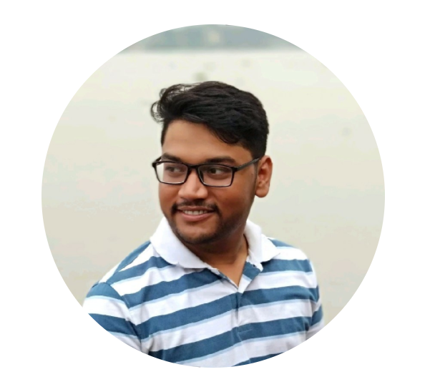
Tada… Farewell Time
CapAMS ki duaayein lete Jaao,
Jaao aapko shukhi organization mile,
PIM ki kabhi na yaad aaye,
new project me itna kaam mile..
Sarupya Paul

Slide 17

THANK YOU

